Slide 1
Data Classification methods and Algorithms with Examples
EVeMa 2018
Blaž Meden, Žiga Emeršič
July 25, 2018

Slide 2
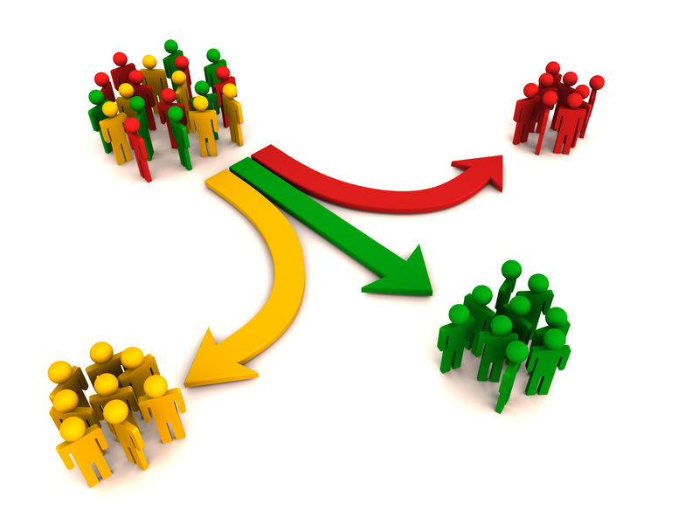
Introduction
What is Data Classification?
Common task in data mining and data analytics.
Main goal is to predict to which category the observed samples belong.

Slide 3
Data Quality & Preprocessing
Obtained data usually has quality related issues:
Missing or inconsistend values.
Duplicated records.
Invalid data.
Outliers.
Before using the data, a preprocessing step is needed where data is prepared, cleaned, transformed, scaled etc.
Domain knowledge can be used to improve the data quality (for example, we can generate best estimations for invalid values).

Slide 4
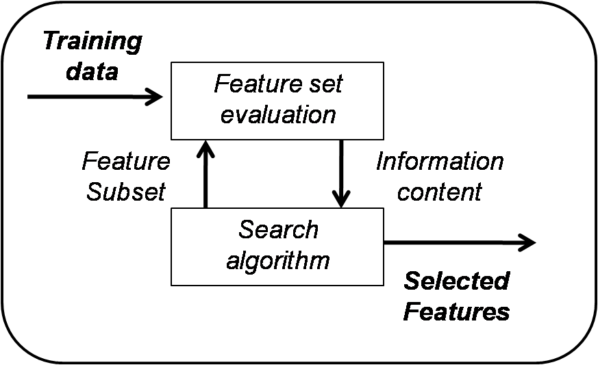
Feature Selection
Certain features (attributes), present in the processed dataset, have better classification capabilities than others.
Usually this removes attributes, that do not give the model any beneficial discriminating power.
Some features can be very correlated or even entirely redundant.

Slide 5
Feature Selection
Basic approach: Backward Elimination Algorithm.
Other measures for attribute purity were also proposed:
information gain, Gain-ratio,
distance measure, weight of evidence,
minimum description length (MDL),
J-measure, Xi and G statistics,
orthogonality of class distribution vectors (ORT),
Gini-index, Relief, ReliefF, etc.

Slide 6
Data Preprocessing
Data preprocessing covers all transformation procedures on the data.
This includes dimensionality reduction:
using either feature selection methods or
simply applying Principal Component Analysis (PCA).
To remap the dataset to lower dimension space.
Other data manipulation and transformations are possible:
such as performing scaling,
filtering (to exclude noise) or
normalization (for example centering the data around reference point 0 and standardizing the range of the values between 0 and 1 or between -1 and 1).
The transformations are depending on the nature of the problem.

Slide 7
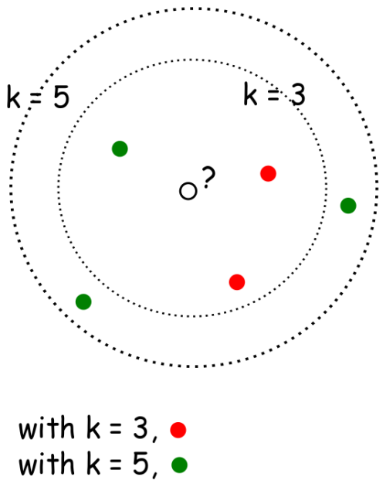
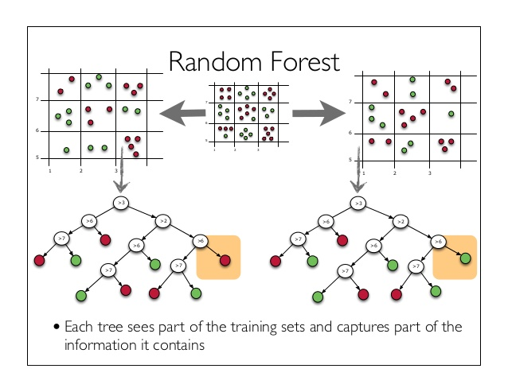
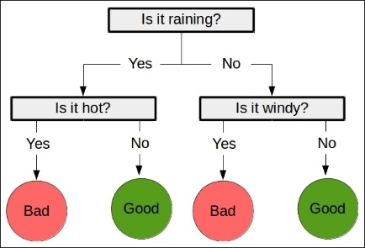
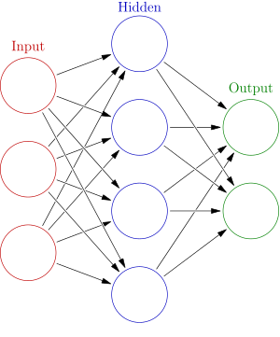
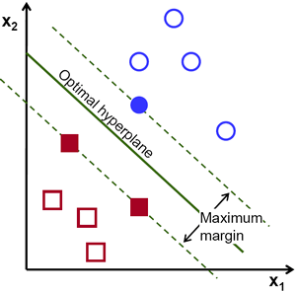
Data Classification Models

Slide 8
Classification Models – Constant (Dummy)
Constant classifier always predicts the same value.
Usually a majority class is predicted.
It can serve as a simple baseline to compare with other (real) classifiers.

Slide 9
Classification Models – kNN
An object is classified by a majority vote of its neighbours.
Object is being assigned to the class most common among its k nearest neighbors,
k is a positive integer and its typically small.
If k = 1, then the object is simply assigned to the class of that single nearest neighbor.

Slide 10
Classification Models – Naive Bayes
Naive Bayes is a classification technique based on Bayes’ Theorem with an assumption of independence among predictors.
In simple terms, a Naive Bayes classifier assumes that the presence of a particular feature in a class is unrelated to the presence of any other feature.

Slide 11
Classification Models – Decision Tree
A decision tree is a flowchart-like structure in which each internal node represents a "test" on an attribute (e.g. whether a coin flip comes up heads or tails).
Each branch represents the outcome of the test, and each leaf node represents a class label (decision taken after computing all attributes).
The paths from root to leaf represent classification rules.

Slide 12
Classification Models – SVM
An Support Vector Machine (SVM) model is a representation of the examples as points in space, mapped so that the examples of the separate categories are divided by a clear gap that is as wide as possible.
New examples are then mapped into that same space and predicted to belong to a category based on which side of the gap they fall.

Slide 13
Classification Models – Neural Networks
An Artificial Neural Network (ANN) is based on a collection of connected units or nodes called artificial neurons (a simplified version of biological neurons in an animal brain).
Each connection (a simplified version of a synapse) between artificial neurons can transmit a signal from one to another.
An artificial neuron that receives the signal can process its value and then forwards the result to the artificial neurons connected to it.

Slide 14
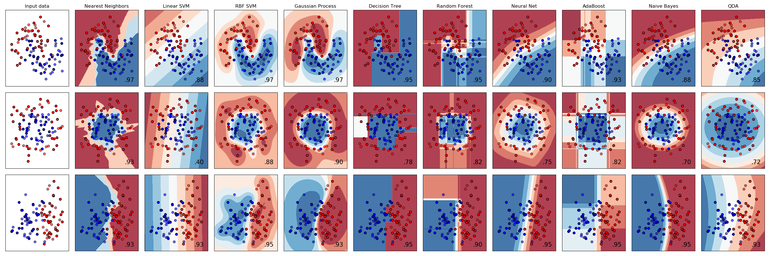
Classification Models – Visual Example
Comparison of a several classifiers in one of Python‘s scientific data analysis libraries (scikit-learn) on synthetic datasets.

Slide 15
Exercise – Dataset
Autonomous Vehicle Survey of Bicyclists and Pedestrians in Pittsburgh, 2017
Dataset consists of 813 entries, providing 17 attribute columns and 4 meta attributes.
We defined target variable (class) from the attribute which describes whether residents approved or disapproved such technology to be used on the roads.
There were five possible categories: approving, somewhat approving, being neutral about it, somewhat disapproving or totally disapproving the usage of Autonomous Vehicles.

Slide 16
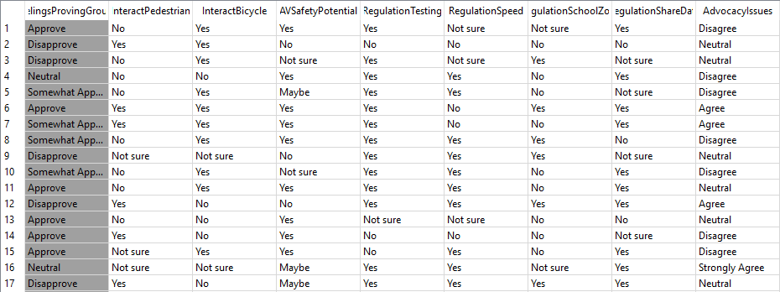
Exercise – Dataset Column View

Slide 17
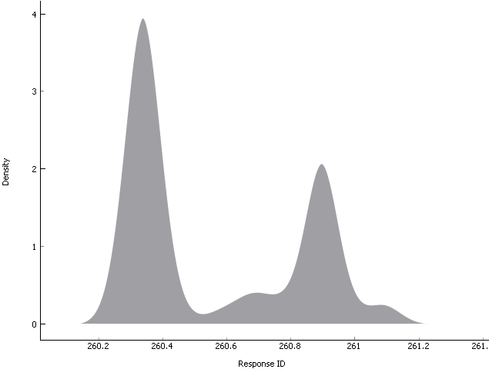
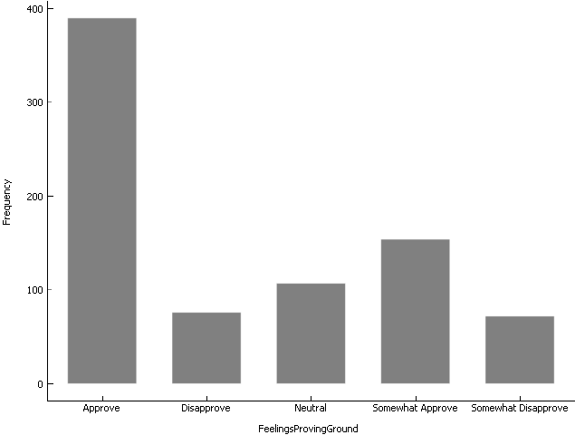
Exercise – Dataset Distributions Examples

Slide 18
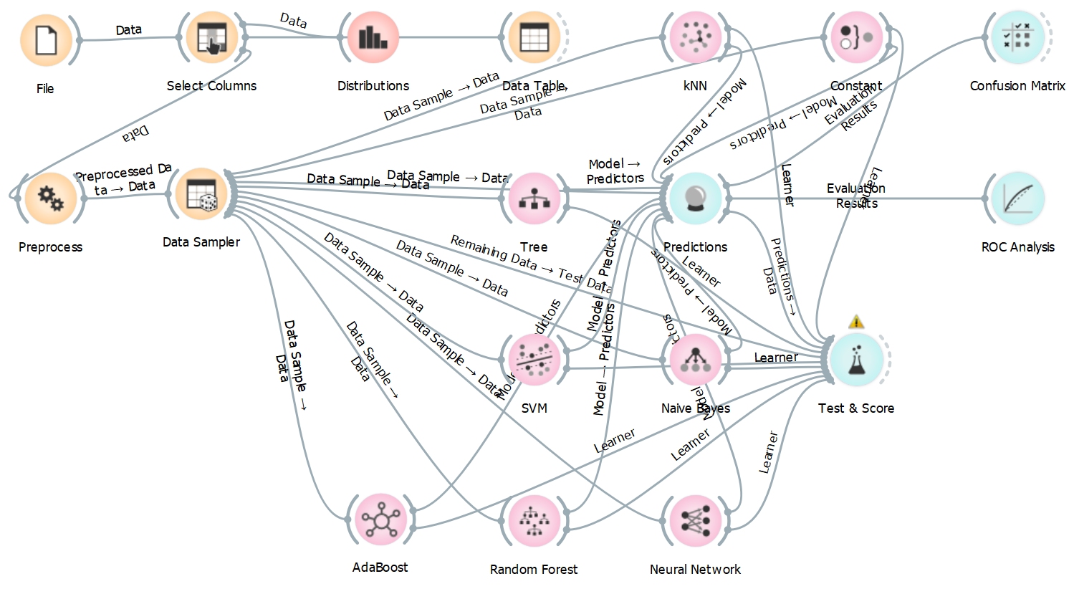
Exercise – Orange Workflow

Slide 19
Exercise – Workflow Protocol
Data loading from CSV file.
Column selection / filtering.
Data preprocessing with the following steps:
Attribute selection by using Information Gain.
Normalization (centering by mean, scaling by standard deviation).
Data sampler randomly samples the dataset to:
70% training samples, 30% testing samples.
Model fitting on training samples.
Model evaluation on test samples (visualisation, matrices, metrics).

Slide 20
Exercise – Classifier Effectiveness
The effectiveness of an classification method as a list of descriptive measures as defined by Golfarelli and Rizzi (2009):
Predictive accuracy (how well it predicts categories for new observations).
Speed (computational cost).
Robustness (performing on low quality data).
Scalability (efficient with large amounts of data).
Interpretability (gives understandable results).
Usually we want numerical results, supported by the experiments themselves.

Slide 21
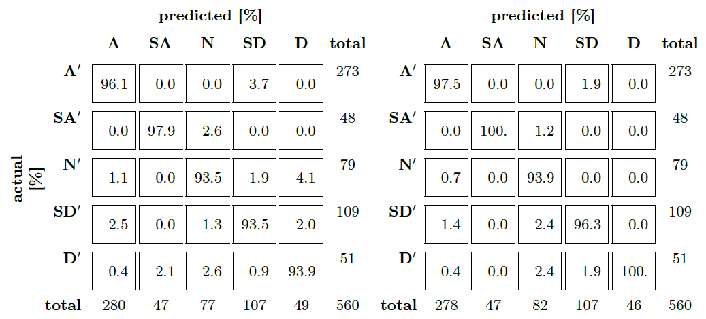
Exercise – Evaluation – Confusion Matrix

Slide 22
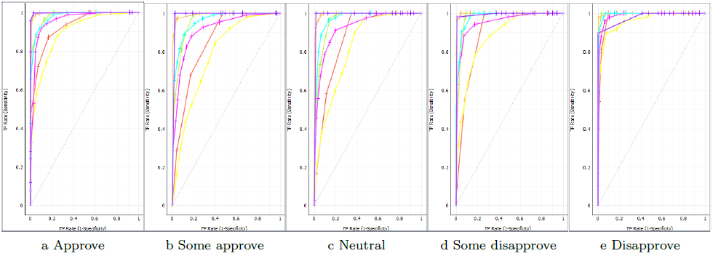
Exercise – Evaluation – ROC Curve

Slide 23
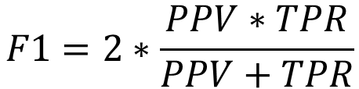
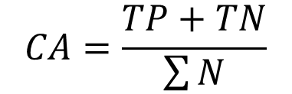
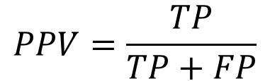

Exercise – Evaluation – Metrics
AUC – Area Under the Curve
CA – Classification Accuracy:
Precision (Positive Predictive Value – PPV):
Recall (True Positive Rate – TPR):
F1 score:
$$CA=\frac{TP+TN}{\sum{N}}$$
$$PPV=\frac{TP}{TP+FP}$$
$$TPR=\frac{TP}{P}$$
$$F1=2∗\frac{PPV∗TPR}{PPV+TPR}$$

Slide 24
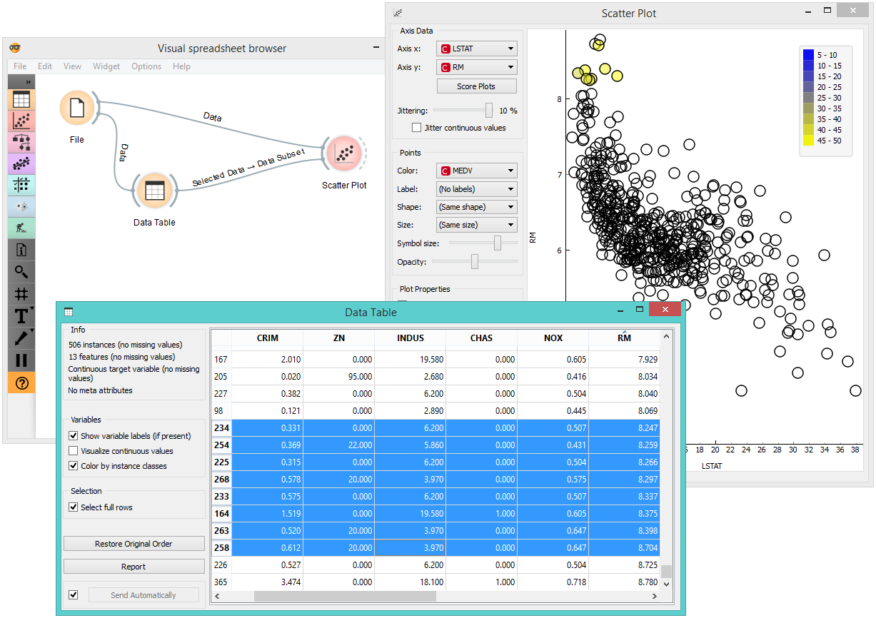
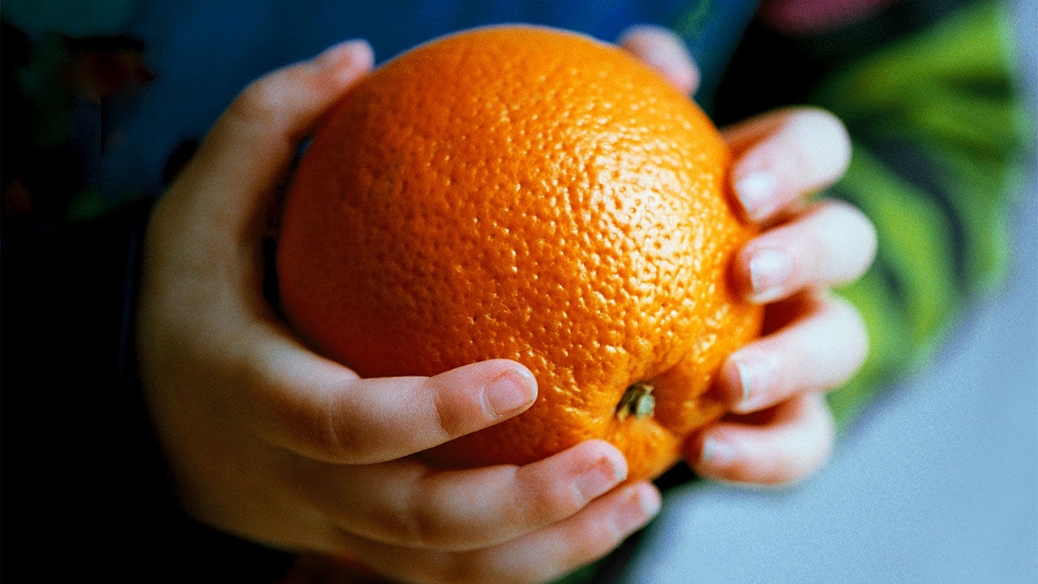
Demonstration – Hands On Orange
Developed by Biolab at Faculty of Computer Science, University of Ljubljana, Slovenia, Europe.
Get your own on: https://orange.biolab.si/

